Slide 1

Week 11 Deliverables
Group Name: The Data Doctors
16-Dec-2023

Slide 2
Team Details
Name: Noah Gallego Email: noahgallego394@gmail.com Country: United States College/Company: California State University Bakersfield Specialization: Data Science | Name: Tomisin Abimbola Adeniyi Email: tomisin_adeniyi11@yahoo.com Country: Nigeria College/Company: N/A Specialization: Data Science
Name: Mohammad Shehzar Khan Email: mshehzarkhan@gmail.com Country: Turkey College/Company: Koç University Specialization: Data Science | Name: Ashish Sasanapuri Email: sashrao21@gmail.com Country: India College/Company: N/A Specialization: Data Science

Slide 3
Problem Description
One challenge for all Pharmaceutical companies is to understand the persistence of a drug as per the physician's prescription. To solve this problem ABC Pharma company approached an analytics company to automate this process of identification.

Slide 4
Data Description

Slide 5
Data Understanding
The dataset provides the factors impacting the patient’s persistence to New Therapy Medication (NTM) by ABC pharmaceutical company prescribed by various physicians.
The aim is to build a machine-learning model that classifies the patient into Persistent (Compliant) and Non-persistent (Non-Compliant).
The dataset consists of 3242 records and is a an imbalanced dataset due to low number of Persistent records as compared to Non-persistent.

Slide 6
Data Understanding
The dataset contains a total of 69 features that are divided into multiple categories -
1 Target variable: Persistency_Flag
1 Unique identifier for each patient: Ptid
6 Demographic variables of the each patient: Age_Bucket, Gender, Race, Ethnicity, Region, Idn_Indicator
3 Physician Specialist attributes: Ntm_Speciality, Ntm_Specialist_Flag, Ntm_Specialist_Bucket
13 Clinical factors: T-Score details, Risk_Segment details, Multiple risk factors count, DEXA details, Fragility fracture details, Glucocorticoid details
45 Disease/Treatment factors: Injectable drugs, Risk factors, Comorbidities, Concomitancies, Adherence to therapy

Slide 7
Data Analysis

Slide 8
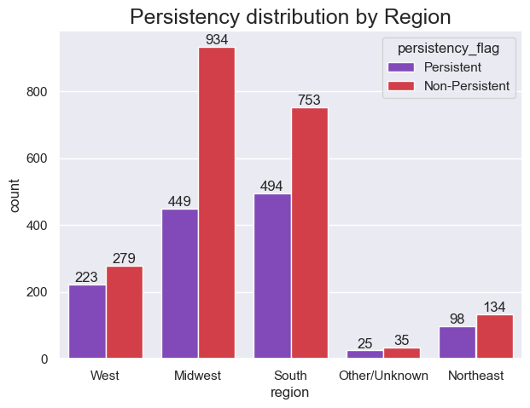
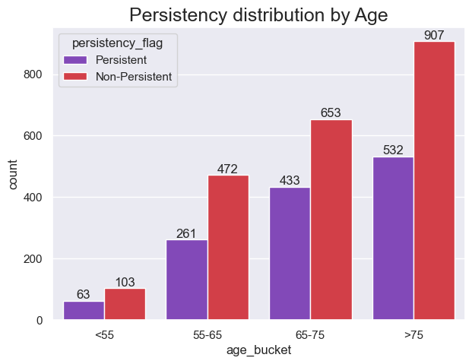
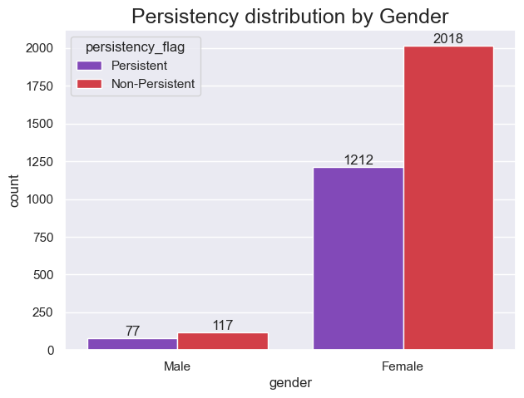
Demographic Data
Majority of the patients recorded are Females and most of them are Non-Persistent to NTM therapies.
We can observe that majority of the patients are aged above 55 years and majority Non-Persistent patients fall in the age group of more than 75 years of age.
Midwest, South, and West regions display majority of the patients recorded.

Slide 9
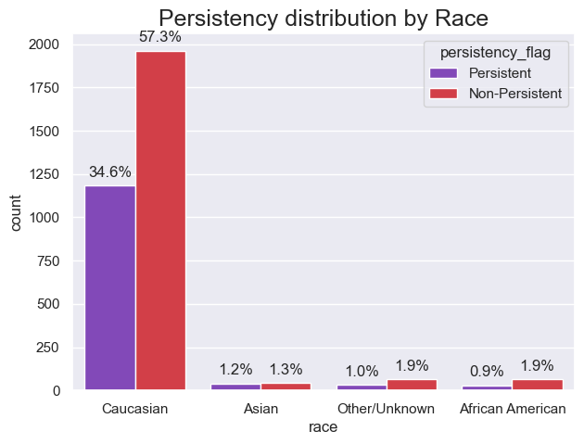
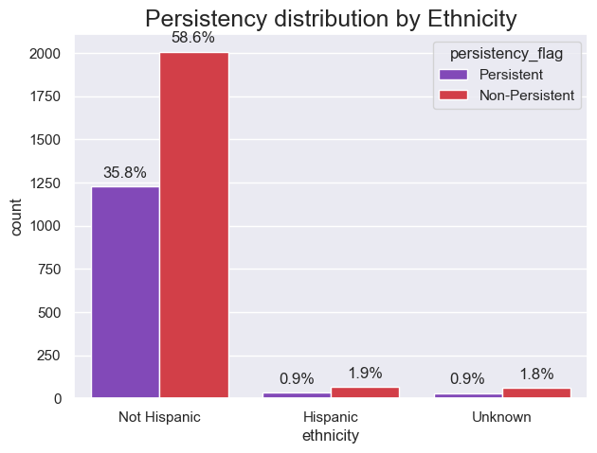
Demographic Data
We can see that majority of the patients are Caucasian and Non-Hispanic.

Slide 10
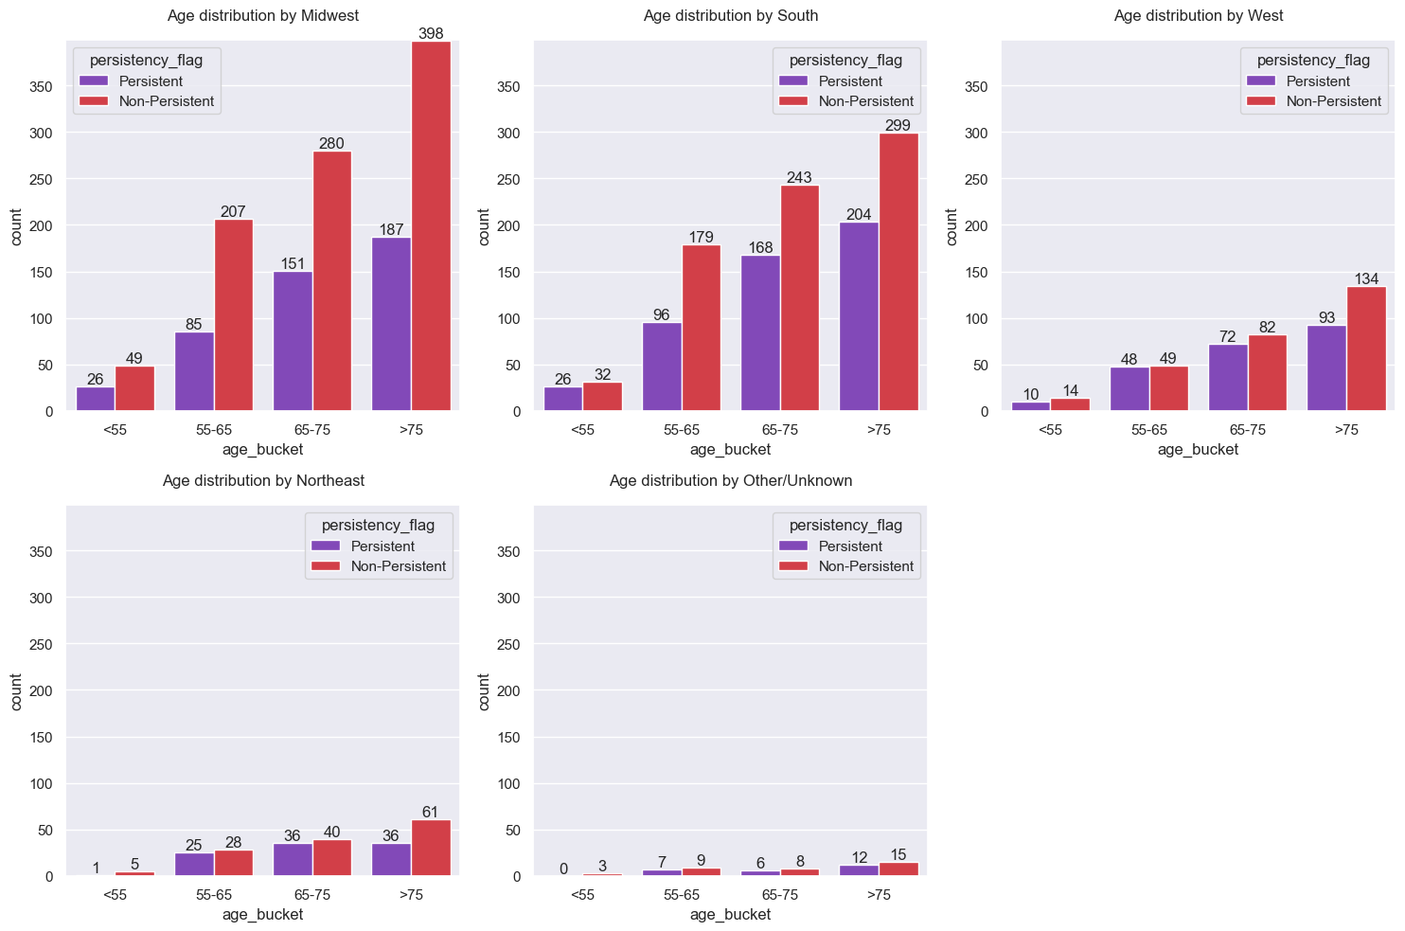
Demographic Data
Majority of Non-Persistent patients belong to the age group above 75 years in the Midwest region.

Slide 11
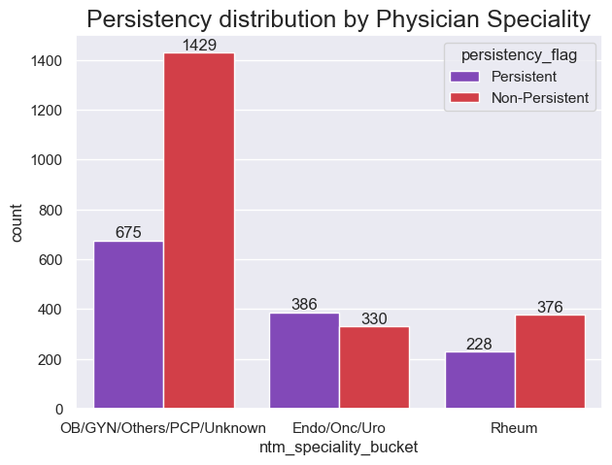
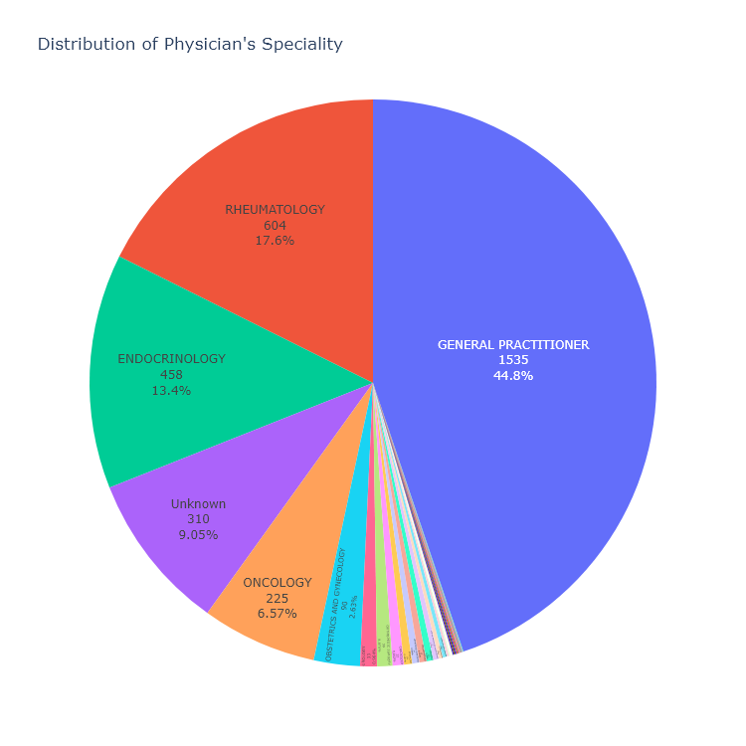
Physician Attributes
Around 45% of Physicians who have prescribed new medication to the patients are ‘General Practitioners’.

Slide 12
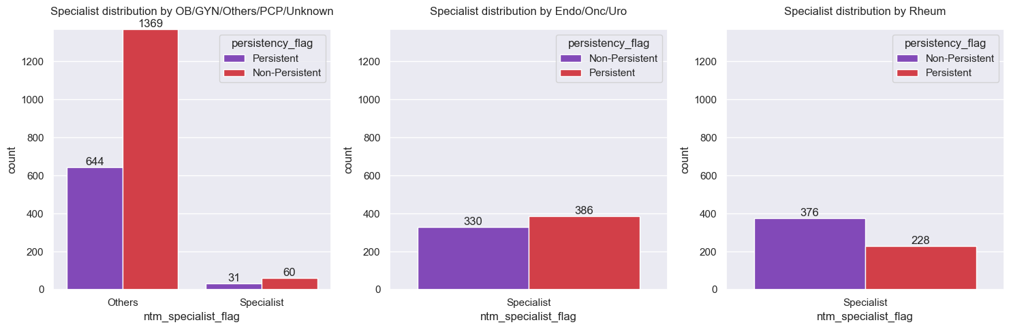
Physician Attributes
Majority of the Non-Persistent patients have been prescribed the new medication by Physicians who are not Specialists.

Slide 13
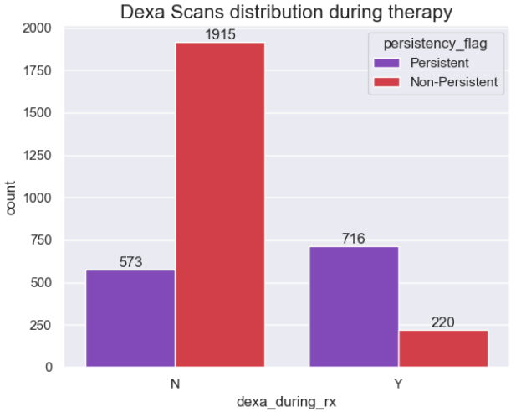
Clinical Factors
Based on the below graph, the Dexa Scans is part of the therapy and majority of patients who haven't gone through Dexa Scans are Non-Persistent.

Slide 14
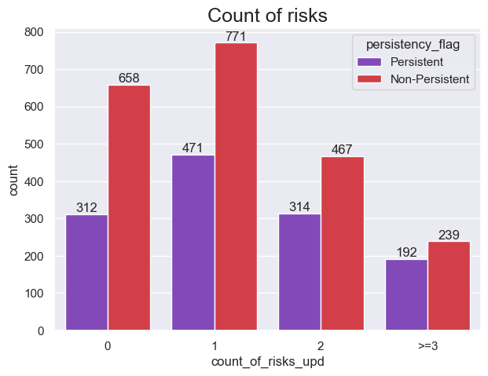
Risk Factors
As the number of risks per patient increases, the number of Non-Persistent patients decreases.

Slide 15
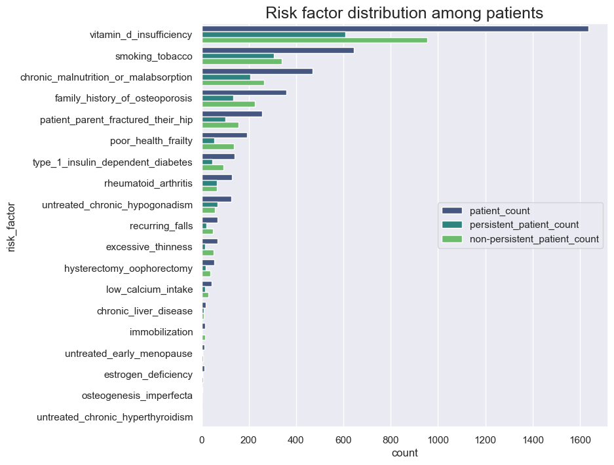
Risk Factors
Majority of the patients have been susceptible to Risk Factors such as ‘Vitamin D insufficiency’, ‘smoking tobacco’, ‘chronic malnutrition or malabsorption’ and have a ‘family history of osteoporosis’.
Due to heavy imbalance of data in Risk Factor categories, we can reduce dimensionality by reducing the categories capturing less data into a single category.

Slide 16
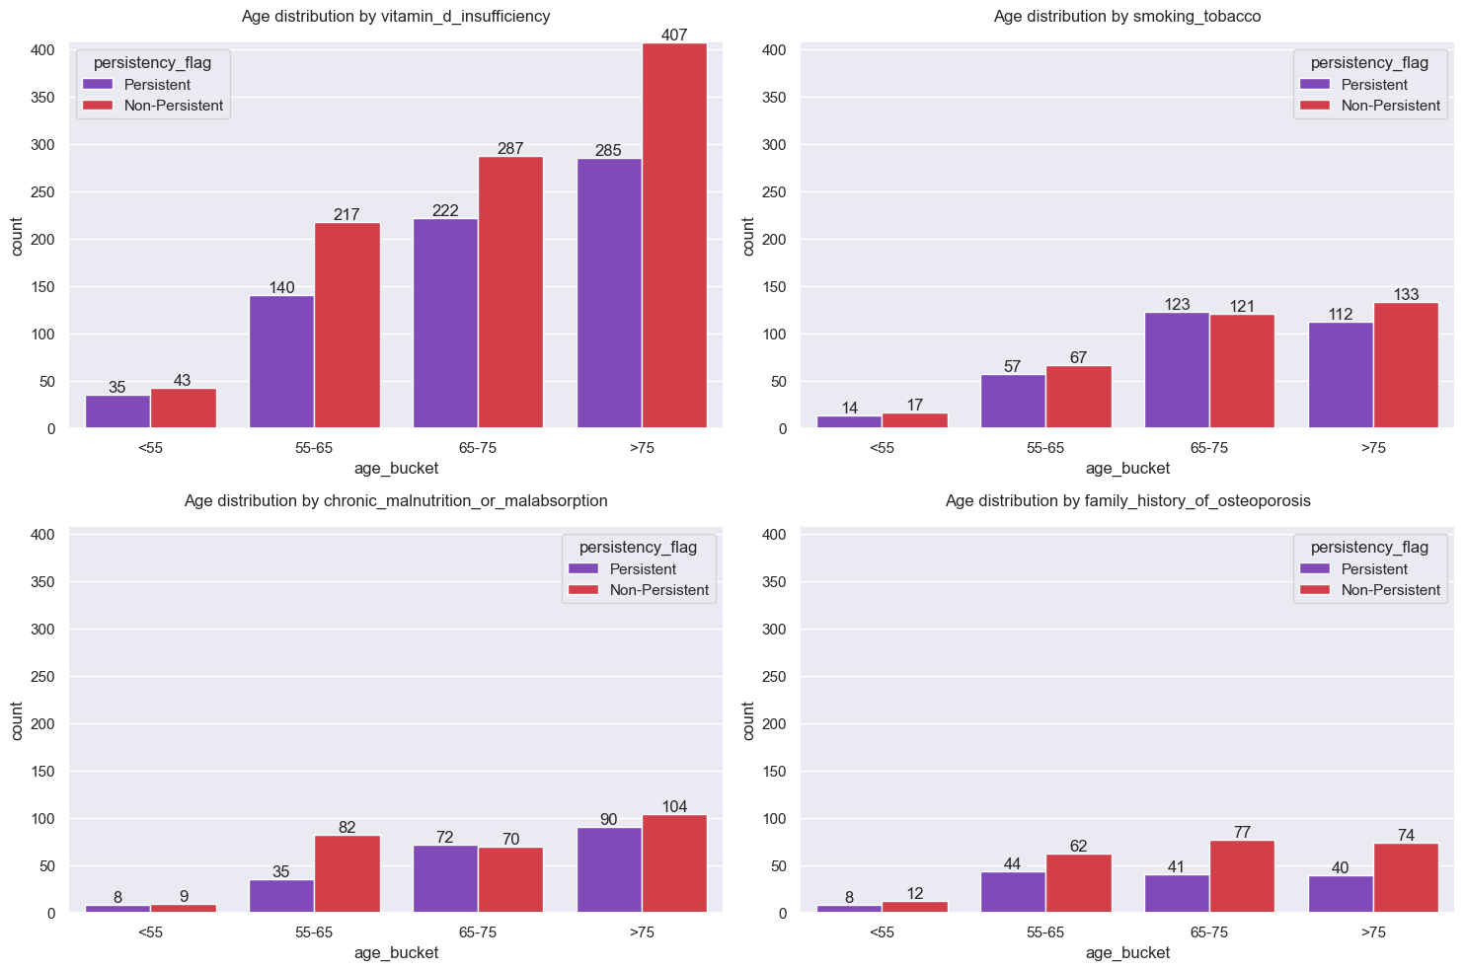
Risk Factors
Below graph displays the distribution of top Risks between different Age groups 1 year prior starting NTM therapy.

Slide 17
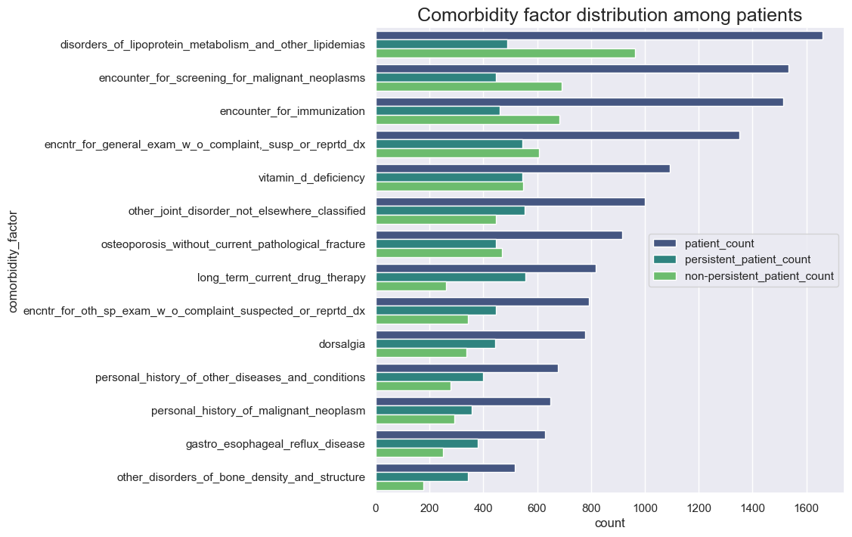
Comorbidity Factors
There are total 14 Comorbidity Factors recorded for each patient.
The top Comorbidity Factors include disorders_of_lipoprotein_metabolism_and_other_lipidemias, encounter_for_screening_for_malignant_neoplasms, encounter_for_immunization, and encntr_for_general_exam_w_o_complaint,_susp_or_reprtd_dx.

Slide 18
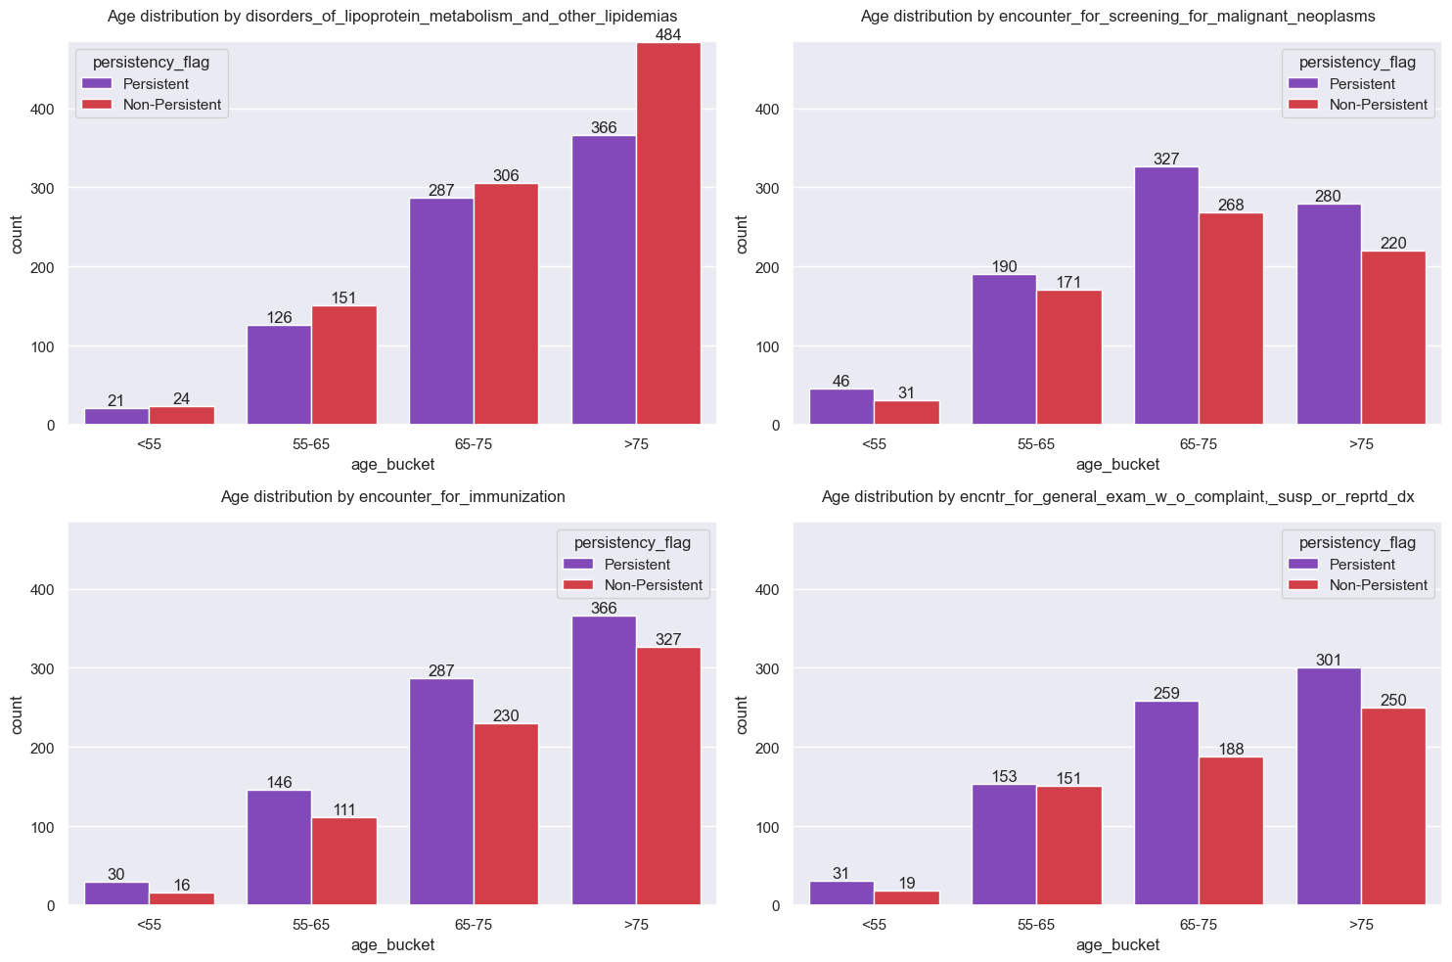
Comorbidity Factors
Below graph displays the distribution of top Comorbidities between different Age groups 1 year prior to NTM OP therapy.

Slide 19
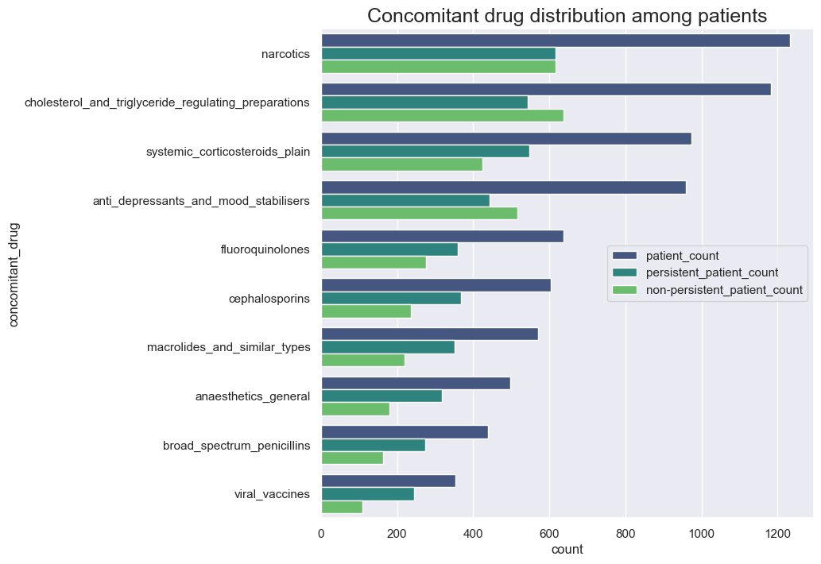
Concomitant Drugs
We can see that the graph shows the distribution of patients who have received Concomitant Drugs 1 year prior to start therapy.
The count for Non-Persistent patients who have been given Concomitant Drugs such as Narcotics, cholesterol_and_triglyceride_regulating_preparations, and anti_depressants_and_mood_stabilisers is greater compared to the other categories.

Slide 20
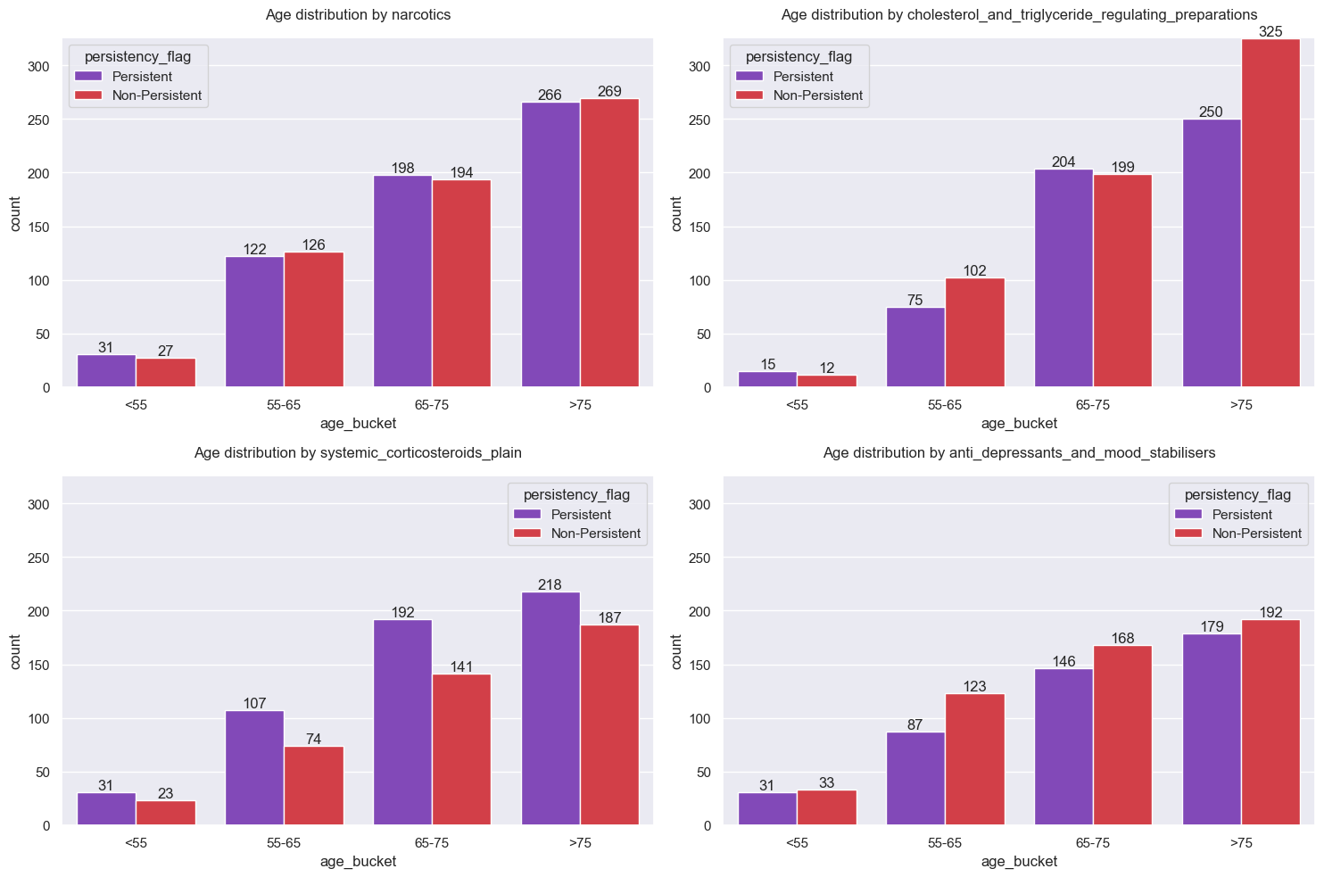
Concomitant Drugs
Below graph displays the distribution of top Concomitant Drugs administered to patients between different Age groups 1 year prior to NTM OP therapy.

Slide 21
Recommendations

Slide 22
Recommended Models
Majority of the attributes in the dataset are categorical in nature. Label Encoding will help in converting the data type from string to numerical.
As the problem statement requires a classification model, following models are recommended - Logistic Regression, Support Vector Classifier, Random Forest, Decision Tree Classifier etc.
Model optimisation can be carried out by applying Grid Search with Cross Validation as it helps in hyper-parameter tuning.
Methods like Recursive Feature Elimination, Attribute Relevance Analysis, Principal Component Analysis(PCA) can be employed to handle dimensionality and complexity of dataset.
Performance metrics such as AUC-ROC curves, Accuracy, and F1-Score will help us understand the performance of the models.

Slide 23
Thank You

